Slide 1


Our contribution to the 1 + 2 model in Scotland

Slide 2
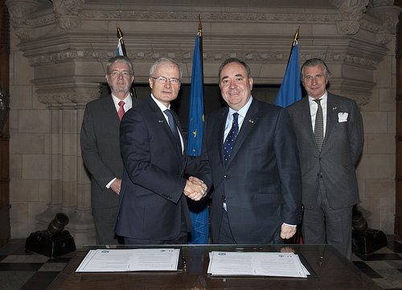
Signature of the agreement in the educational area between Scotland and France

Slide 3
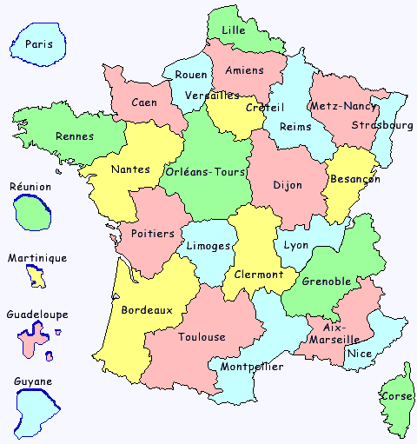
Supporting links between schools, teachers, pupils within local authorities in Scotland and in France
Stirling/ ELA Lille
Fife / ELA Créteil
Dumfries & Galloway / ELA Nancy-Metz
South Lanarkshire / ELA Reims
Renfrewshire/ ELA Lyon
Aberdeen / ELA Clermont Ferrand
Westlothian / ELA Grenoble
Glasgow / ELA Aix-Marseille

Slide 4
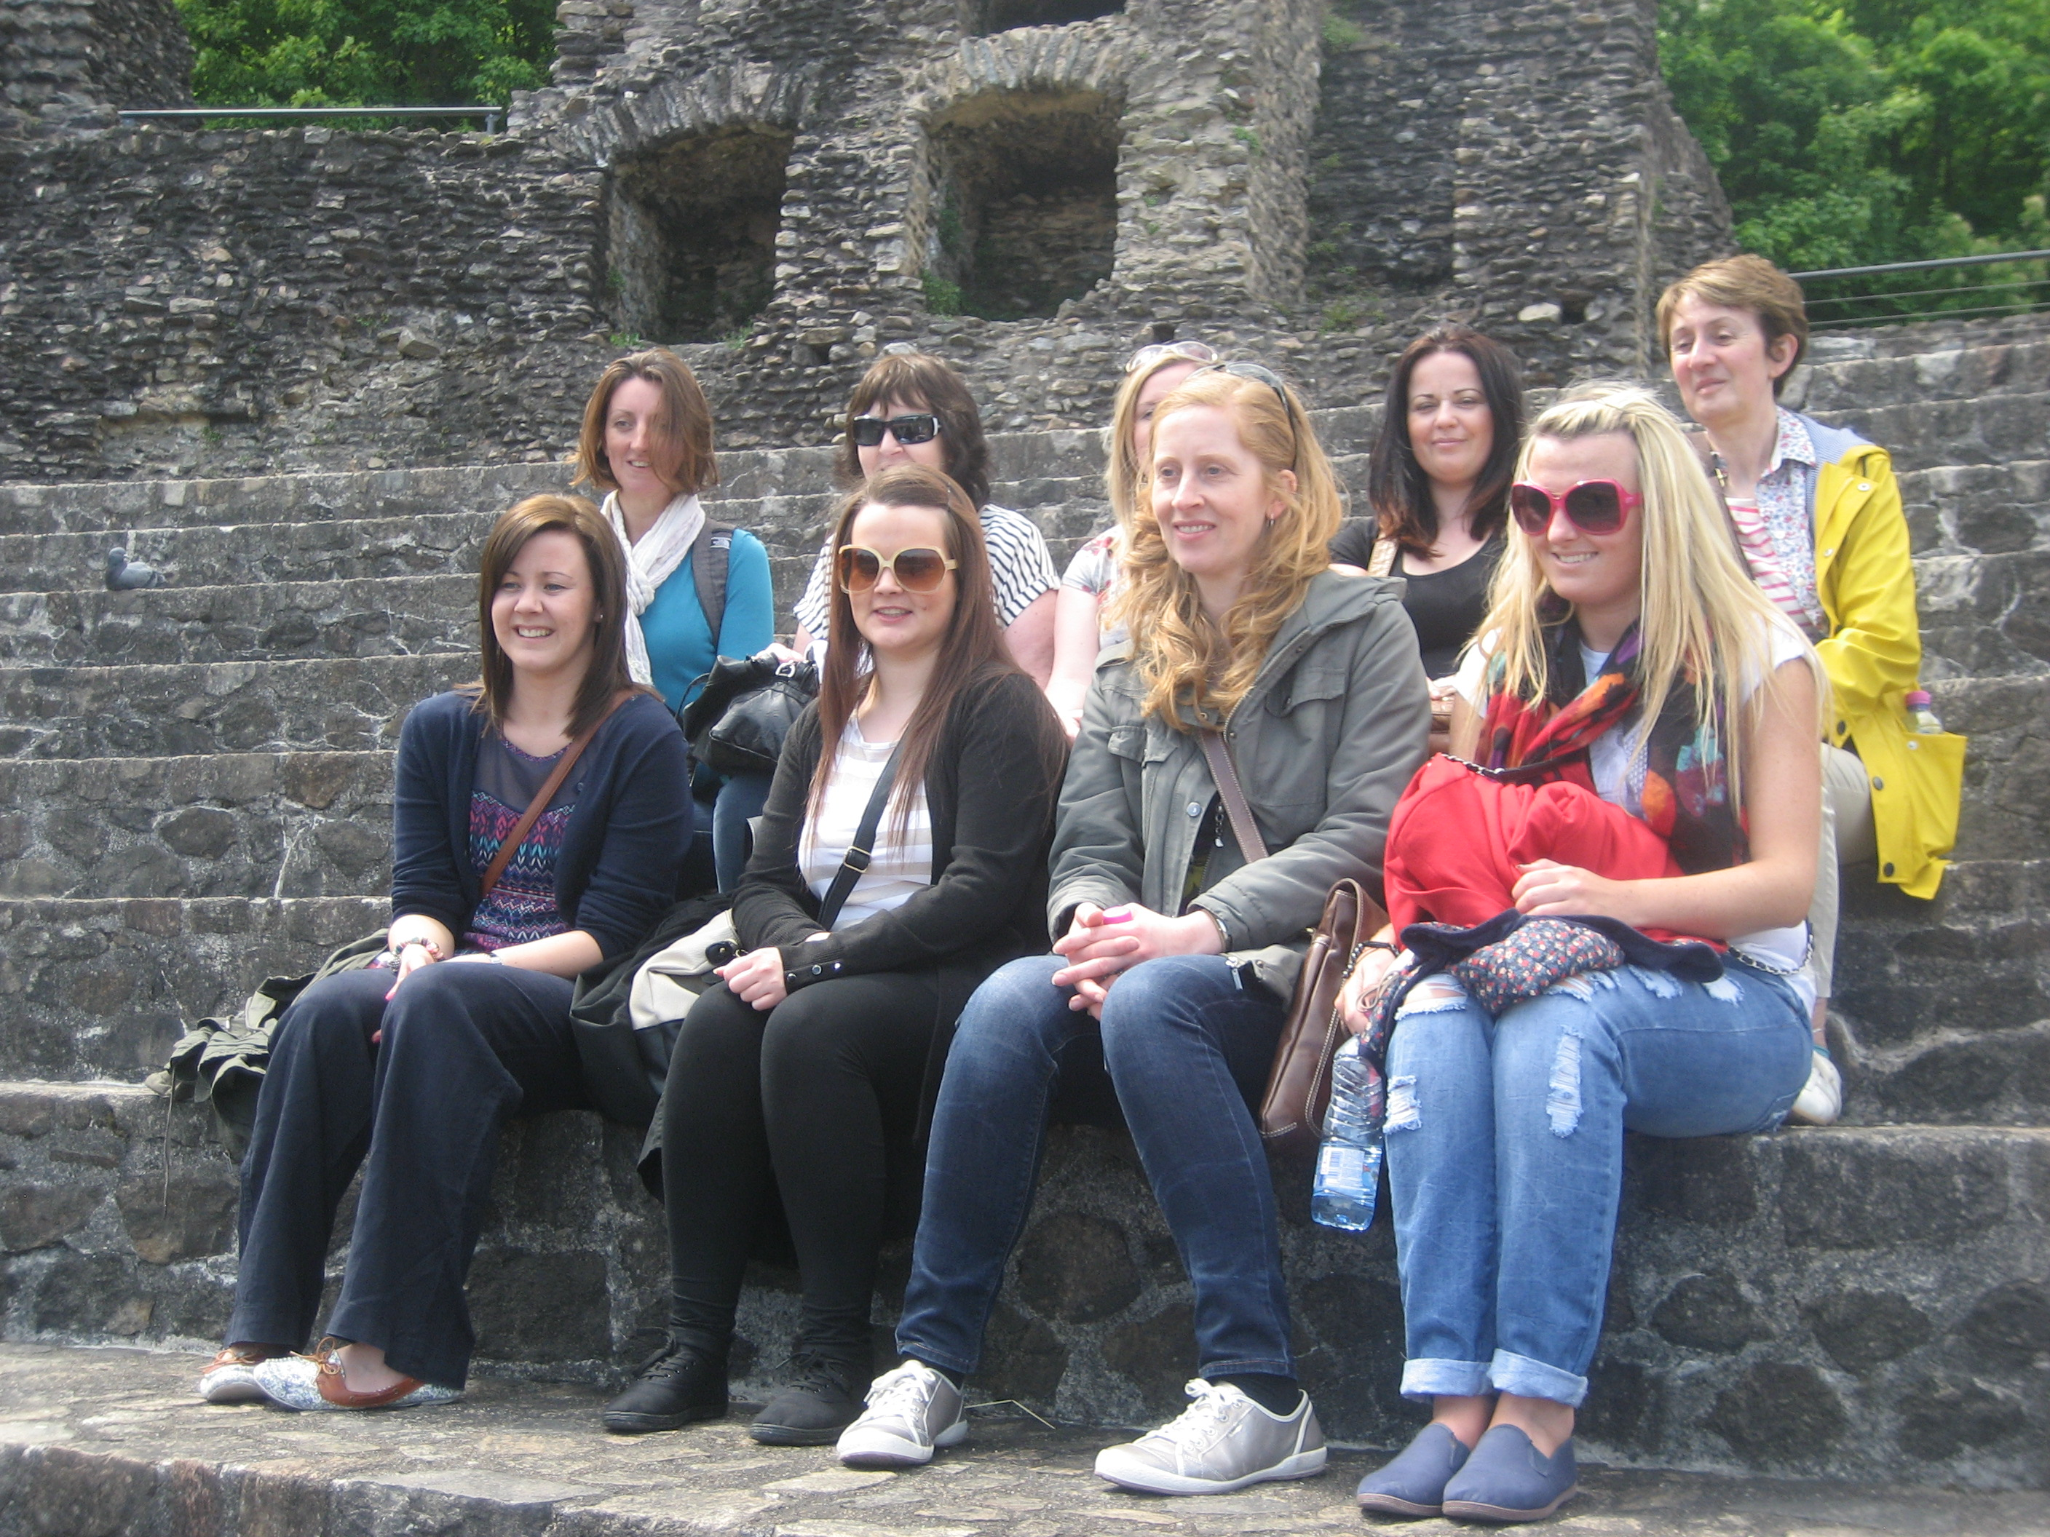
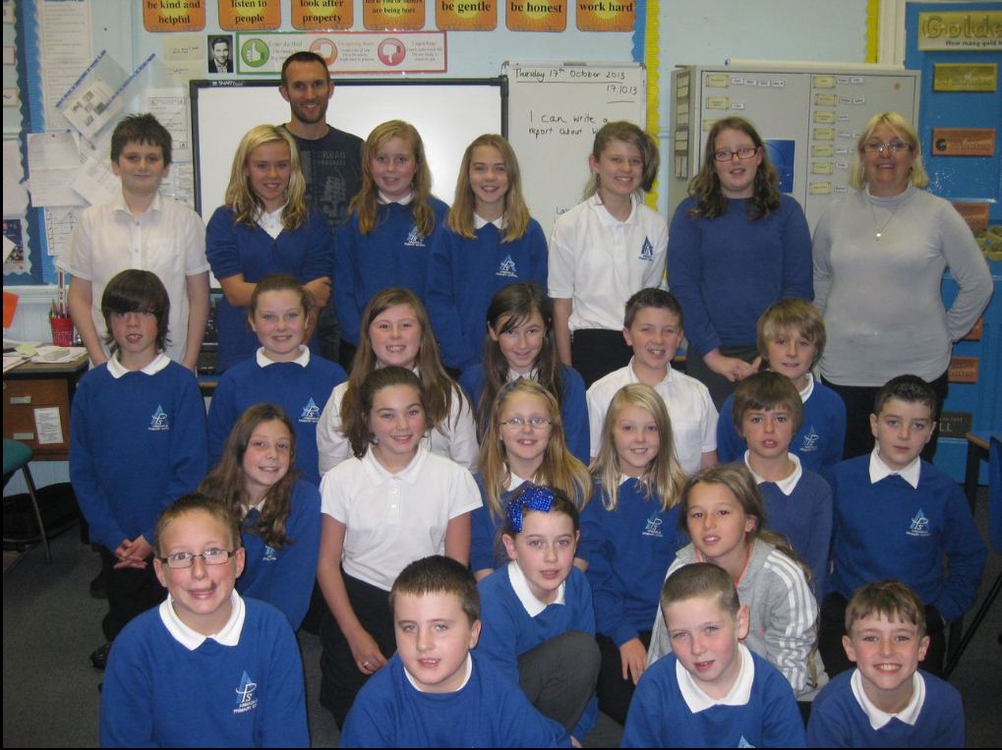
Links between Scottish & French LA, teachers and schools
Teachers from Renfrewshire in Lyon
Teachers from Grenoble in Westlothian
Coming soon to Scotland: French teachers
from Nancy-Metz to Dumfries and Galloway
From Lille to Stirling
From Grenoble to Westlothian

Slide 5
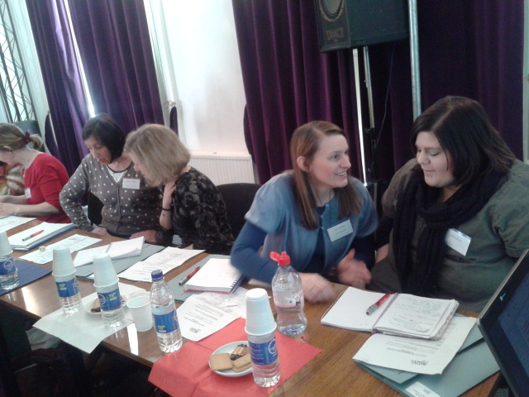

Next CPD opportunity
for primary teachers
French Day on 16 November 2013
at the Institut français in Edinburgh
The French Film Festival UK
7 November to 7 December 2013
7 cities:Glasgow, Edinburgh, Bo’ness, Kirckaldy, Dundee, Inverness and Aberdeen.
Screenings for schools ( with free online resource to download)
Le jour des corneilles (Days of the Crows), an animated fantasy film for primary schools
Comme un lion (Little Lion), a compelling drama about a young Senegalese dreaming of becoming a professional football player in France.
on: www.ifecosse.org.uk/Education

Slide 6
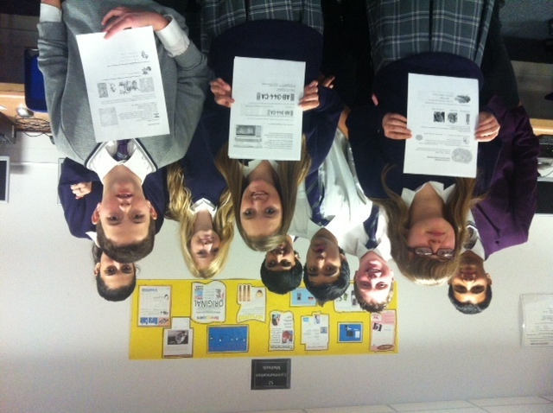
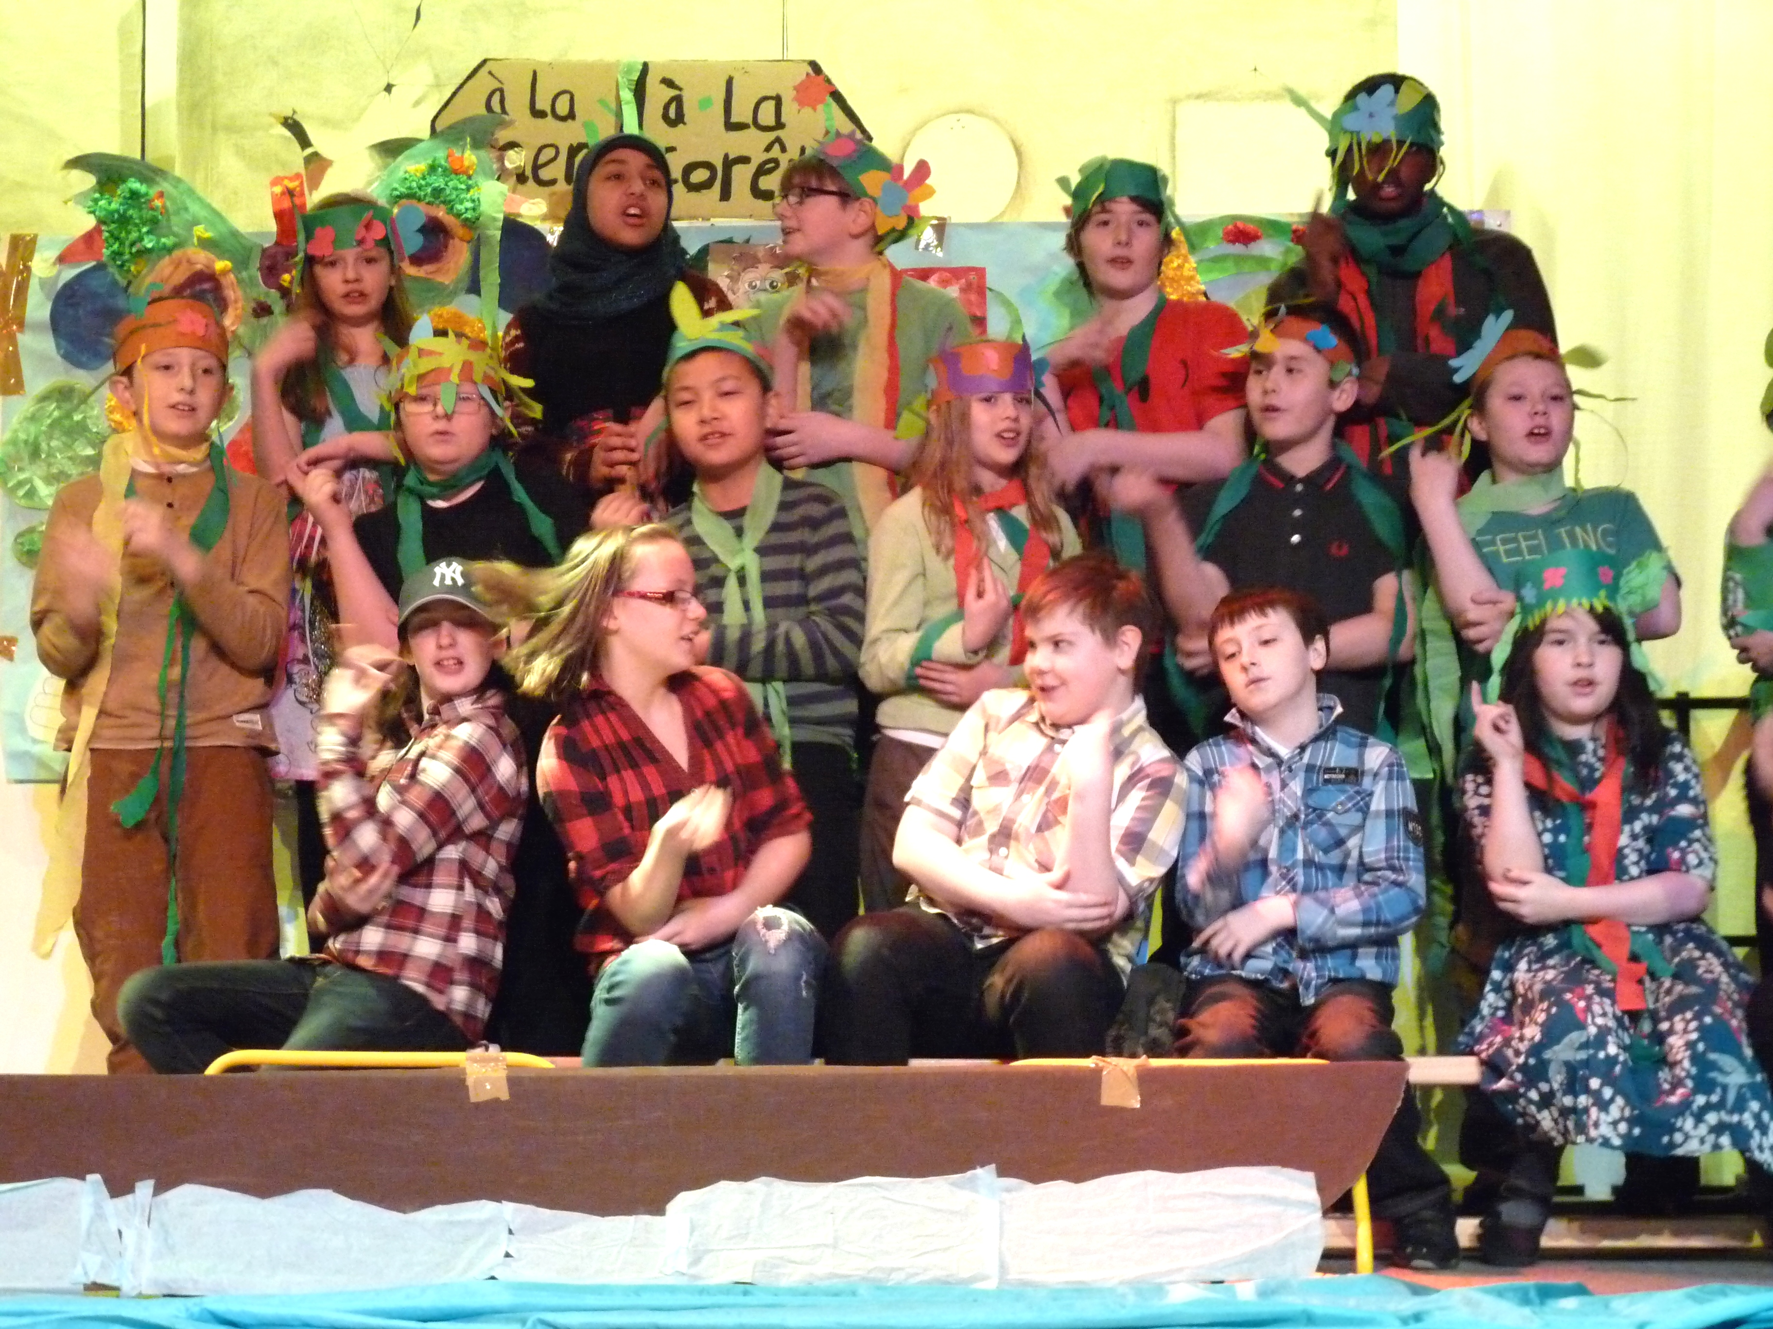
Motivating pupils
Online competition (S2/S3)
« Vive la Francophonie »
on 20 March 2014
Rencontres théâtrales 2014
In Edinburgh on 24 March 2014
In Aberdeeen (dtc)
In Glasgow (dtc)

Slide 7
.
Interested in any of these actions?
Please contact me:
Marie-Christine Thiébaut
education@ifecosse.org.uk
MERCI ! Et à bientôt!

